Slide 1
Section 6.6 Watering down example
MATH A104
Megan Gobeille

Slide 2
6.6: Watering down
How many quarts of water should be added to 3 gallons of stilled whiskey that is 70% alcohol to make it a more palatable 40% alcohol?

Slide 3
6.6: Watering down
How many quarts of water should be added to 3 gallons of stilled whiskey that is 70% alcohol to make it a more palatable 40% alcohol?

Slide 4
6.6: Watering down
How many quarts of water should be added to 3 gallons of stilled whiskey that is 70% alcohol to make it a more palatable 40% alcohol?
Quarts AND gallons in this problem… change one so they match!

Slide 5
6.6: Watering down
How many quarts of water should be added to 3 gallons of stilled whiskey that is 70% alcohol to make it a more palatable 40% alcohol?
Quarts AND gallons in this problem… 3 gallons = 12 quarts
Since we’re talking about how much WATER to add, let’s write everything in terms of % of water.
70% alcohol means _____ % water
40% alcohol means _____ % water

Slide 6
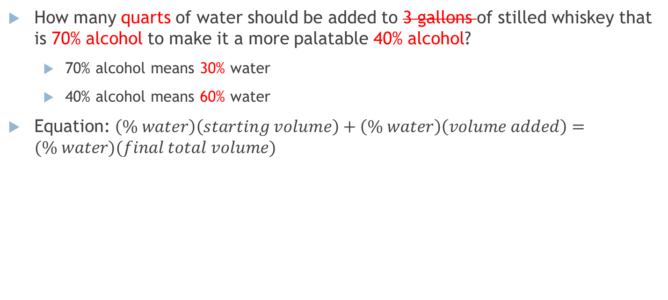
6.6: Watering down
12 quarts
How many quarts of water should be added to 3 gallons of stilled whiskey that is 70% alcohol to make it a more palatable 40% alcohol?
70% alcohol means 30% water
40% alcohol means 60% water
Equation: $\left(\% water\right)\left(starting volume\right)+\left(\% water\right)\left(volume added\right)=(\% water)(final total volume)$

